Slide 1
Steps for finding the Jitter for the PLL project
Reference:
Ratan_MS_THESIS_UIUC_2014.pdf

Slide 2
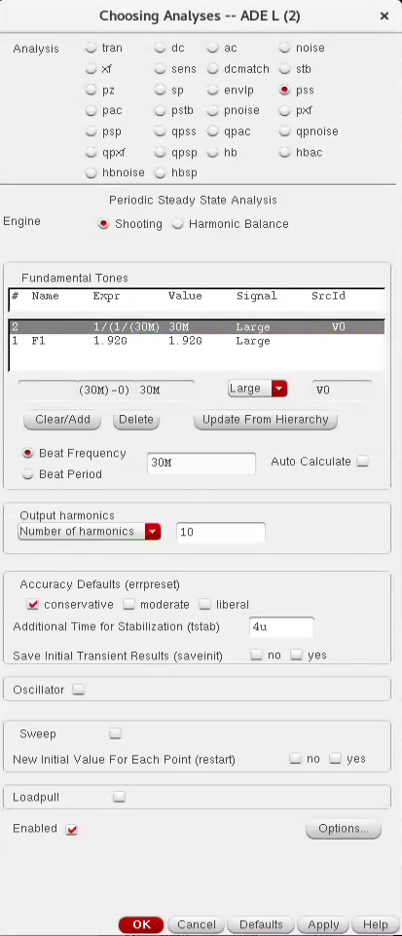
1- Set PSS Analysis
Set the beat frequency to the reference frequency
Don’t check the “Oscillator” box, since the PLL is driven by an external reference source. (It’s not an Oscillator)
Beat Frequency ➔
In a driven system, the beat frequency would be the greatest common divisor of all the input tones in the circuit (or the divided down frequencies if there are dividers in the circuit). PSS needs to solve a periodic waveform - and so you need to have an integer number of cycles of all the frequencies in the circuit.

Slide 3
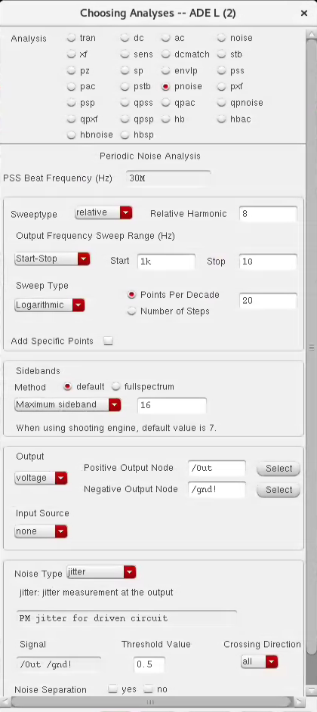
2- Set PNoise Analysis
Set the range around the carrier frequency where the jitter will be integrated
Choose “Jitter” to get the random jitter calculations
Set the crossing threshold of the transient output signal.
(Out signal goes from 0 → 1V, so the crossing threshold will be 0.5V)

Slide 4
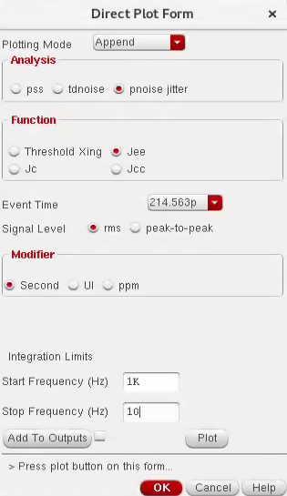
3- After Running the PSS & Pnoise sims
Results → Direct Plot → Main Form
Edge-to-edge jitter
Cycle-to-cycle jitter
The peak-to-peak jitter is measured at certain BER.

Slide 5
References
Spectre_rfmanual: (P. 542)
https://www.ee.columbia.edu/~harish/uploads/2/6/9/2/26925901/spectre_rfmanual.pdf
Ratan_MS_THESIS_UIUC_2014: (P. 93)
http://emlab.uiuc.edu/jose/Theses/Ratan.pdf

